Slide 1
Docker & Containers
Envisioning Application Modernization with Containers

Slide 2
Agenda
Module 1: Introduction to Containers
Module 2: Container Architecture
Module 3: Docker Architecture
Module 4: Application Modernization
Module 5: Understanding Orchestration

Slide 3
Module 1
Introduction to Containers

Slide 4
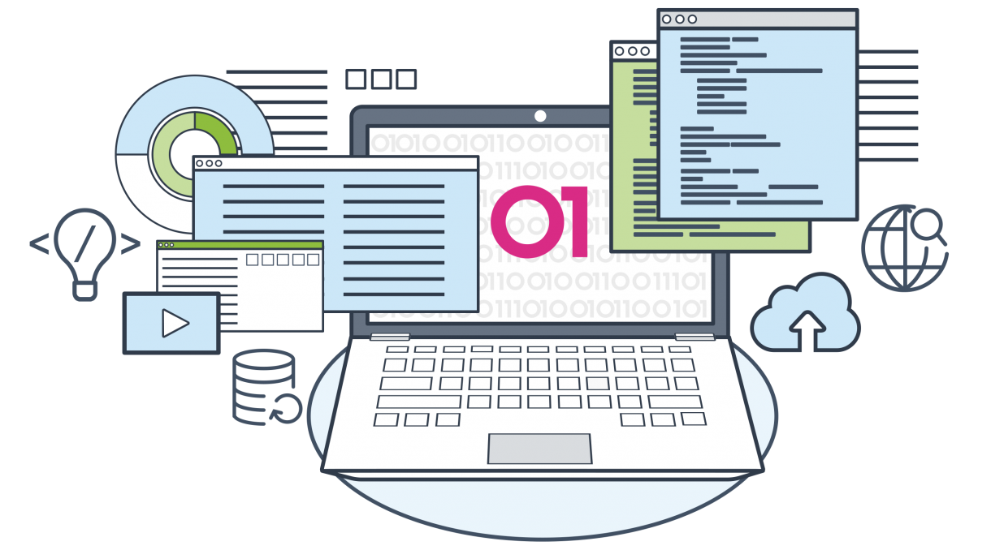
Application packaging strategies
Every Application has certain dependencies.
Libraries provided by Operating System
Libraries provided by runtime environment like Java, Python & Dot Net runtime
Server Runtime like Tomcat for Java, IIS for Asp.net, Apache httpd
Third Party Libraries
Change in Dependencies affects Application.

Slide 5
Application packaging strategies /challenges
Application goes through following phases:
Development
Testing
Staging
Production
Managing dependencies across all these environments could be challenging.
Creating compatible dev-test environment may take considerable time.
Question : Challenges in moving application between environments
Question: List Existing solutions based on Virtualization

Slide 6
Containers as alternative
A Typical container would have application & all its dependencies packed together.
This makes container “decoupled” from targeted environment.
Only restriction being Windows or Linux platform.
Container
Writable Layer
Application Image
Third Party Libs
Runtime (JRE / Python / Node)
Base Image

Slide 7
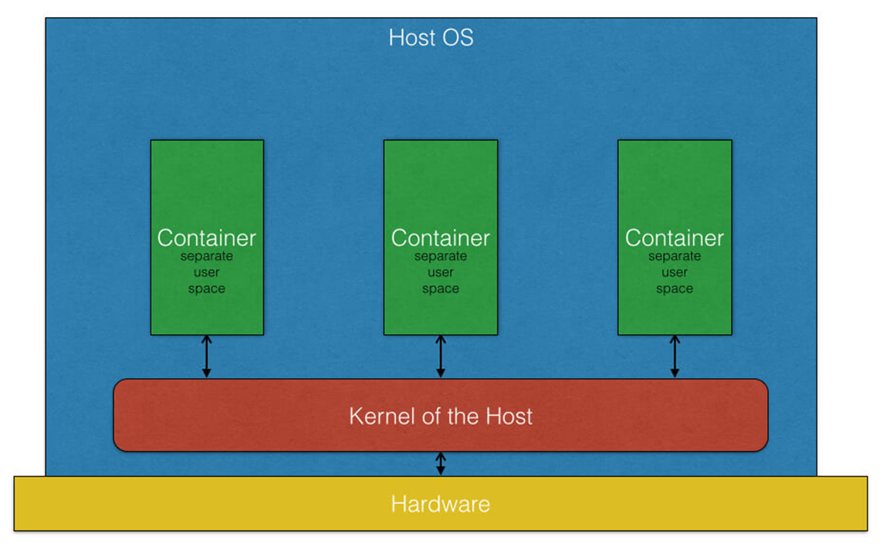
Benefits of Containers
Isolate application from underlying OS and Hardware.
Lightweight, provides higher density than Virtual machines.
Dev-Ops ready. Many CI/CD platforms support container deployments/build.
Every container executes in a separate user space.

Slide 8
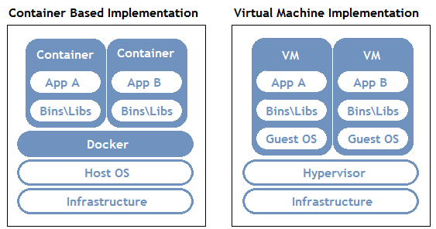

Slide 9
Container vs Virtual machines
Virtual machines provides hardware level virtualization.
Virtual machines contains Operating system.
Virtual machines use guest OS kernel.
Host OS and Guest OS could be completely different.
Booting up VM is equivalent of booting a physical machine.
Containers provide software level isolation, no hardware virtualization.
Containers use “base image” which provide basic OS level libraries but not the OS.
Containers use host OS kernel.
Due to dependence on Host OS Kernel, containers must be deployed on compatible host OS.
Launching container is equivalent of launching an application.

Slide 10
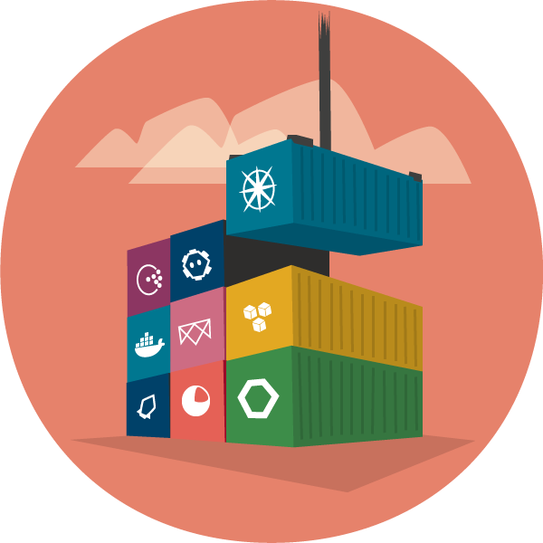
Container platforms
Docker from Docker Inc
LXC from Linux
LXD from Ubuntu
RKT from CoreOS

Slide 11
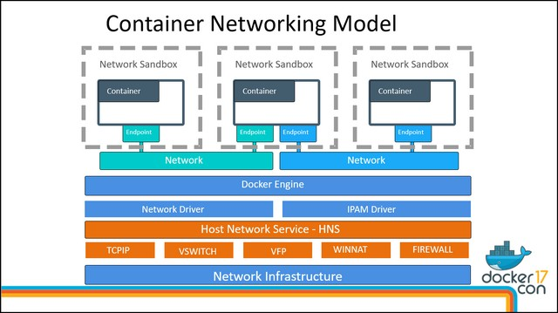

Slide 12
Module 2
Container Architecture

Slide 13
Container & Images
Containers are running instances of image
Image is a read-only filesystem made of “layers”
Each “layer” is an image which may contain a specific application, library or runtime.
Container has an extra “Writable” layer.
The bottom-most image is “base” image.
Writable Layer
MySQL DB Image [Read Only]
Host Kernel
BusyBox Image [Read Only]
Writable Layer
Apache2 HTTP Image [Read Only]
Debian Image [Read Only]

Slide 14
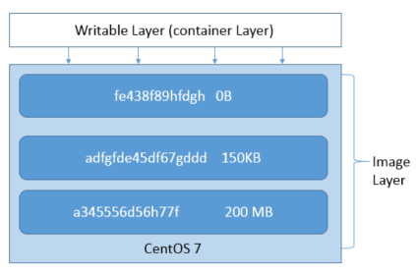
Read-Only vs Writable layers
Read-only layers are shared by multiple containers / images.
Writable layer allows read and write operations
Every container has ONE writable layer.
Every layer has unique ID and meta-data.

Slide 15
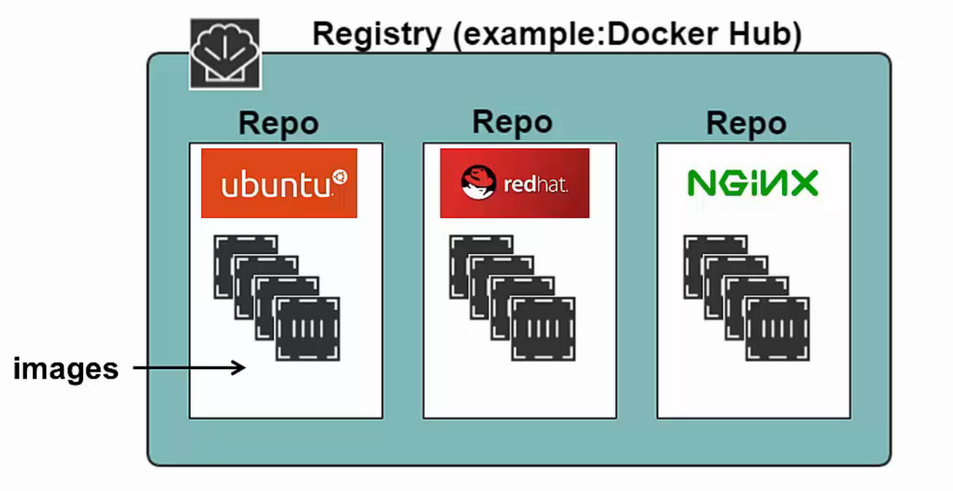
Image repositories
An Image repository is persistent storage for container images
A private repository can be accessed by selected users.
A public repository can be accessed by any one.
A Developer may “Push” application as container image.
An operations team may “Pull” the same image for deployment.
Many cloud platforms do provide “Hosted” container repositories.
Host repositories are managed by vendor.

Slide 16
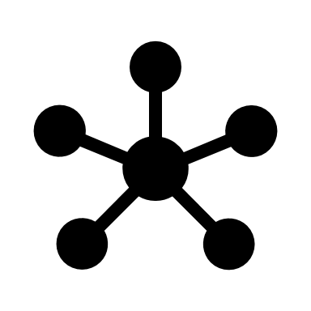
Container Networking
Containers can communicate through a container network.
Container platform like docker have
Multiple network models.
Host Kernel
Container 1
Container 2
Container Network

Slide 17
Container Networks
Bridge Network
Host Network
Overlay Network

Slide 18
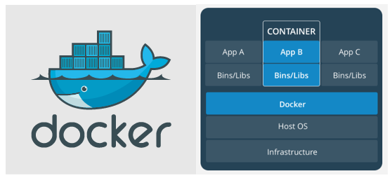
Module 03
Docker Architecture

Slide 19
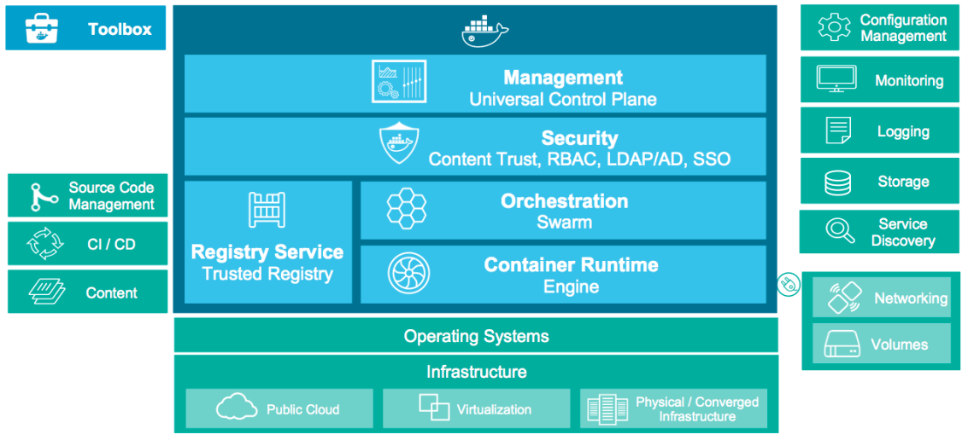
Docker As a Container platform
An open platform for developing, shipping, and running applications.
Started it’s life as a PaaS provider by name dotCloud.
Since its inception, working with linux container.
The container platform was named “Docker”
In 2013, got “rebranded” as Docker Inc.
A container platform based on “runc” and “libcontainer”

Slide 20
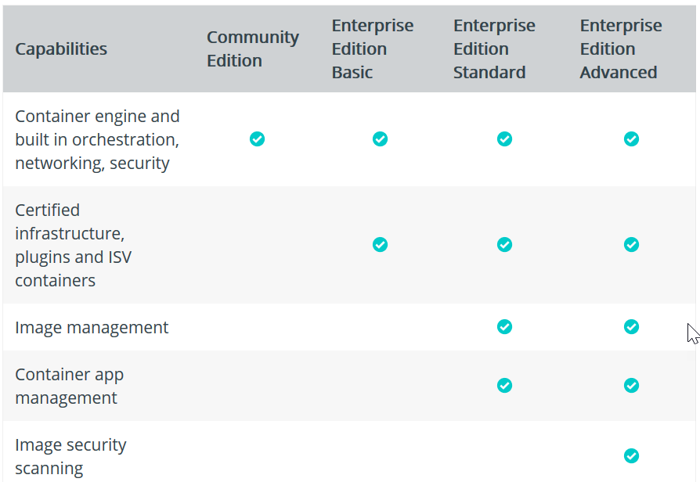
Docker Editions
Community edition (Docker CE)
Ideal for developers and small teams experimenting with containers.
Enterprise Edition (Docker EE)
Enterprise development & IT team for business critical applications at production scale.

Slide 21
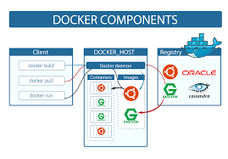
Docker components
Docker engine (docker daemon)
Docker container images
Docker containers
Docker CLI (client)
Docker (REST) API
Docker Registry

Slide 22
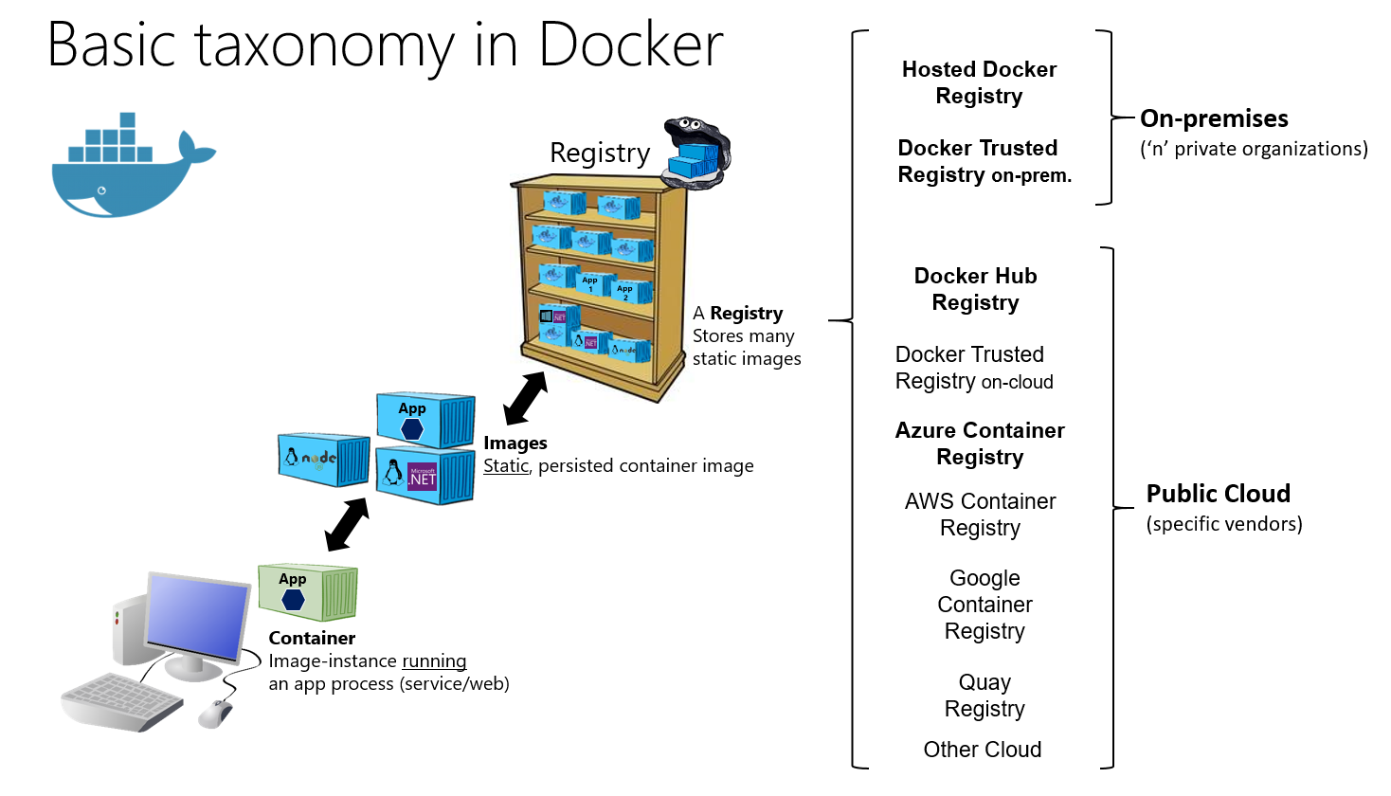

Slide 23
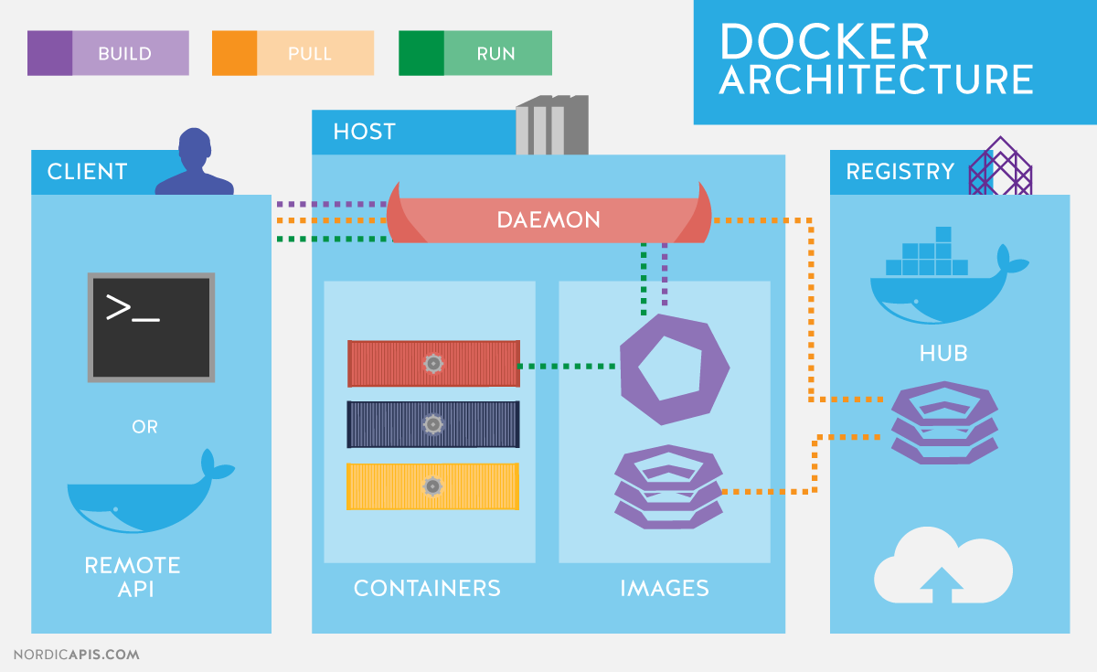
Docker components
Batteries included but “removable” (“replaceable”)
Built in security
Linux hosts can use AppArmor or SELinux
Namespaces to restrict access to host system resources.

Slide 24
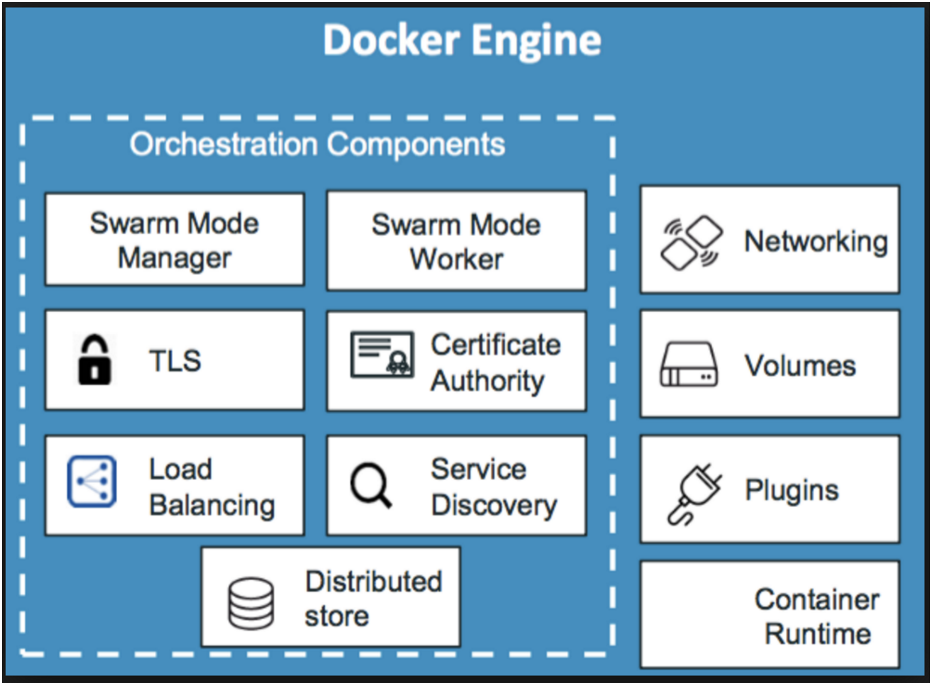
Docker on Windows & Linux hosts
Docker being only container platform supporting both Windows and Linux.
Windows based container supported only on Windows 10 PRO and Windows Server 2016.
Docker installation on windows uses different components than linux host.
Images built for linux cannot be deployed on windows hosts.
Windows do have a trick: docker-machine and moby project to run linux containers through a lightweight VM.

Slide 25
Module 04
Application modernization

Slide 26
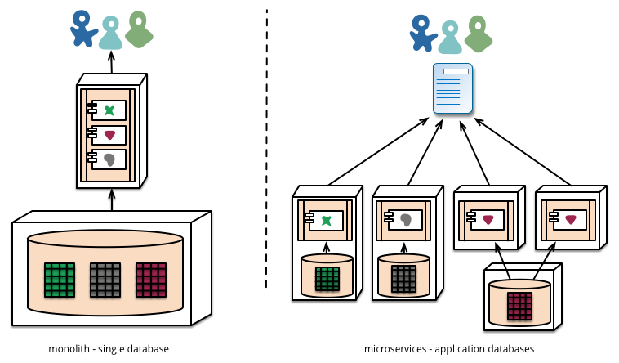
Application types
A multi-layered monolith application
A distributed application / SOA
Micro-services
Containers do support all of them!
Monolith = Single large Container for App
+ DB Container
Distributed = Container for each Service / Module

Slide 27
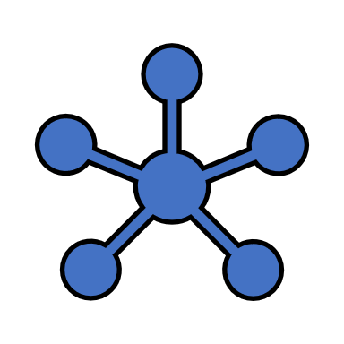
A typical TWO TIER Application
Back End App Container
Front End App Container
Back End App Container
Front End App Container
Back End App Container

Slide 28
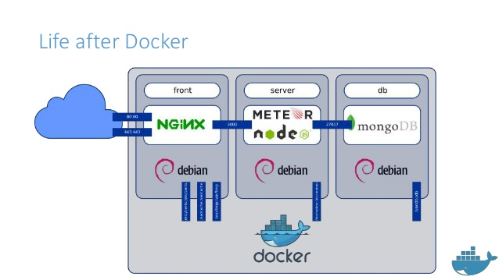

Slide 29
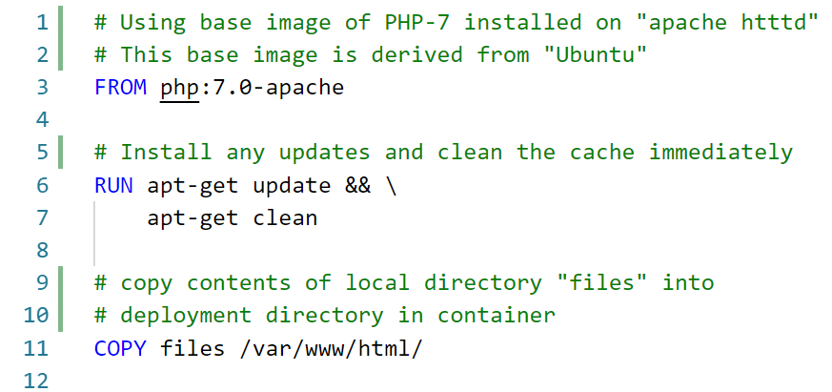
Dockerfile
Automates the “Build” process of a container.
Integrates with all popular CI/CD tools.
Simple language to define entire build workflow
Basic system administration commands needed.
Windows : prefer powershell
Linux: prefer bash
Can be placed in SCM

Slide 30
Dockerfile reference
Command | Description
FROM | Initializes a new build and define “base” image to be used for building.
RUN | A Step to be executed in build process. Can be used for installing necessary package.
CMD | Provide DEFAULT “startup” action for container. Must be used only ONCE.
LABEL | Provides additional META-DATA like Author name
EXPOSE | A Hint for port used by container, can be overridden at run-time.
ENV | Define environment variables.
COPY | Copy files from host system to container. NOTE : optional feature --chown for linux containers

Slide 31
Module 05
Understanding Orchestration

Slide 32
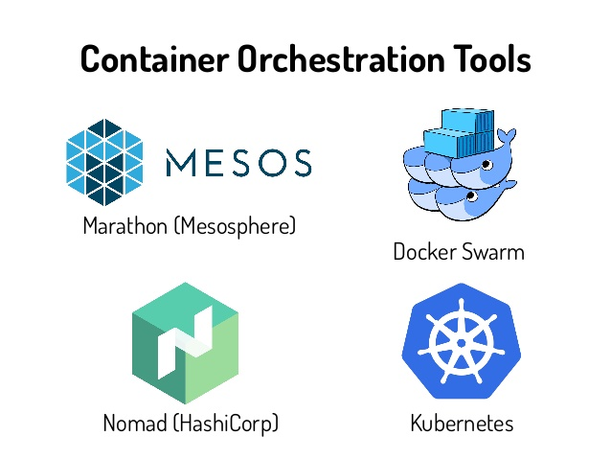
Orchestration
Need for Orchestration
Ephemeral computing
Desired State
Cluster management
Container Orchestration platforms
Docker Swarm (from Docker Inc)
Kubernetes (from Google)
DC/OS (based on Apache Mesos)
Nomad (from HashiCorp)

Slide 33
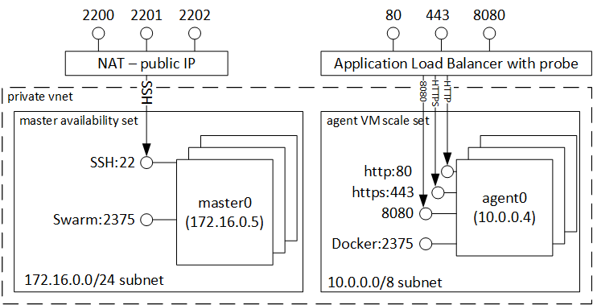
Docker Swarm
Cluster management integrated with Docker engine
Decentralized design (for cluster management)
Declarative service model (ref: docker-compose)
Scaling
Desired state reconciliation
Multi-host networking
Service discovery
Load balancing

Slide 34
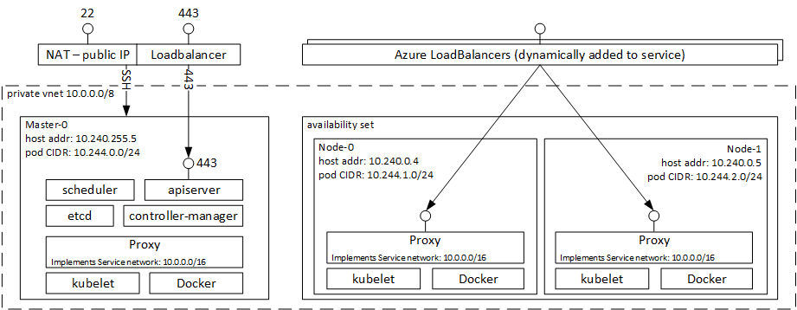
Kubernetes
Cluster managed from google with 10+ years of internal use by google.
Open source, run anywhere
Service discovery
Load balancing
Self healing
Storage orchestration
Scaling

Slide 35
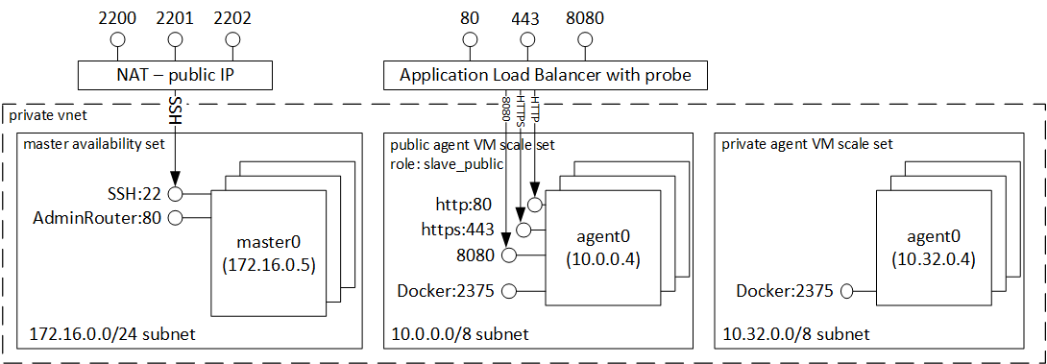
DC/OS
Distributed OS based on Apache Mesos
Treat cluster as a single machine
High resource utilization
Container orchestration using “Marathon”
Cloud agnostic installation

Slide 36
Q/A

